Slide 1

Microsoft //build/ 2016
Matthew Burleigh
Senior Developer, Pandora Jewelry
https://about.me/matthew.burleigh
March 30 – April 1, 2016, San Francisco, CA
Notes:
https://channel9.msdn.com/Events/Build/2016

Slide 2
Pandora //build/ Team
Mark Sengamalay
Phillip Kennedy
Eric Rubin
Stan Bice
Todd Steele

Slide 3
Xamarin is Free!!!!
Notes:
https://channel9.msdn.com/Events/Build/2016/KEY02#time=18m32s (ScottGu keynote announcement)

Slide 4
Xamarin Tools
Free for all versions of Visual Studio
Open Source
MIT License
iOS Emulator for Visual Studio
Xamarin joins the .NET Foundation
Workbooks (https://developer.xamarin.com/guides/cross-platform/workbooks/)
Inspector (https://developer.xamarin.com/guides/cross-platform/inspector/)
Notes:
https://www.dotnetfoundation.org/blog/welcoming-xamarin-to-the-net-foundation
http://open.xamarin.com/
http://forums.dotnetfoundation.org/

Slide 5
Xamarin is Free!!!!

Slide 6
.NET Core & ASP.NET Core 1.0
RC2 available now
Tooling is considered as “preview 1”
RTM by end of June
Tooling will be considered “preview 2”
Tooling will RTM with Visual Studio “15”
Preview 2 available at https://www.visualstudio.com/downloads/visual-studio-next-downloads-vs
http://dot.net/
Side by side installations

Slide 7
.NET Core 1.0
.NET on all platforms
Windows, Linux, OS X
Android & iOS (Xamarin)
.NET on all devices
Raspberry Pi/Arduino ➔ 32 core/448GB RAM (GS5 VM) ➔ distributed cluster (Azure Service Fabric/Akka)
.NET on any cloud
Azure, EC2, GDE, Docker, OpenStack
Also – Docker on Windows!!! Woo hoo!!!
Notes:
https://dotnet.github.io/
https://cloudplatform.googleblog.com/2016/05/how-to-get-your-ASP-NET-app-up-on-Google-Cloud-the-easy-way.html
https://blogs.aws.amazon.com/net/post/TxSBK1AHRGLHVC/Exploring-ASP-NET-Core-Part-1-Deploying-from-GitHub

Slide 8
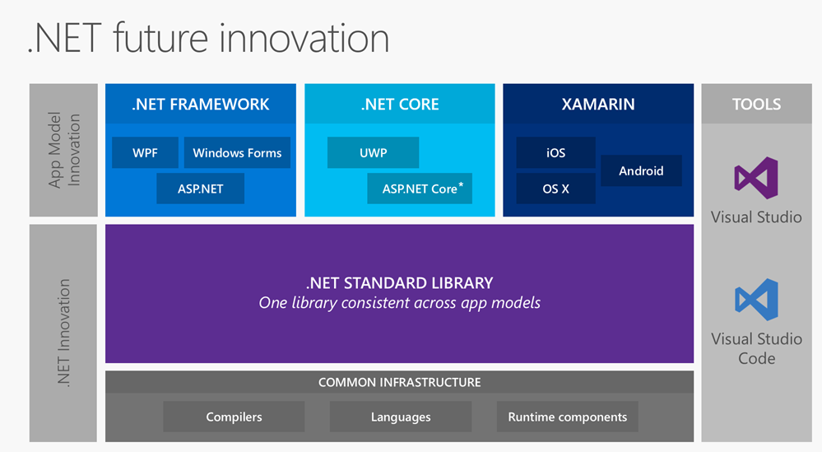
.NET Core 1.0
http://www.hanselman.com/blog/AnUpdateOnASPNETCore10RC2.aspx
Notes:
https://dotnet.github.io/

Slide 9
ASP.NET Core 1.0
Built on a new .NET Execution Environment (DNX)
Runs on framework 4.6 & Core 1.0
Completely OSS when running on .NET Core 1.0
Unified controller classes
Modular, composable middleware
Routes can include only necessary support modules (think non visible)
Includes support for package managers other that NuGet (Bower, NPM)
Event bindings for build tasks (Gulp)
Tag helpers simplify markup
Notes:
<%= [html encode some code output here] %> ➔ <%: [code something here] %> ➔ @ [code something here] ➔ asp-for

Slide 10
Cortana Intelligence Suite
Bot Framework
Add capability to any “conversational canvas”
Bot Connector
Bot Builder SDK
Bot Emulator
Cognitive Services (https://www.microsoft.com/cognitive)
22 APIs available (Vision, Speech, Language, Knowledge, Search)
Machine Learning
LUIS (Language Understanding Intelligent Service)
Utterance ➔ Intent (confidence interval)
CRIS (Custom Recognition Intelligent Service)
Notes:
https://channel9.msdn.com/Events/Build/2016/KEY01#time=1h54m02s
www.botframework.com
http://docs.botframework.com/connector/tools/bot-framework-emulator/
https://www.microsoft.com/cognitive-services/en-us/language-understanding-intelligent-service-luis

Slide 11
Bots all the Things!
Bot as assistant
Cortana Developer Preview (Glympse & JustEat integrations)
Conversation as a Platform (Caap)
Bots cover the “long tail”
Human language as extensible UI
Ubiquitous
Conversation can replicate any GUI experience
Facebook Messenger Platform
Chat bots for Messenger
Chat widgets for web
Google Allo
Smart reply = machine learning/nlp/computer vision
Amazon Echo
Skills development
Notes:
https://developers.facebook.com/blog/post/2016/04/12/bots-for-messenger/

Slide 12
Azure
IoT Suite
https://azure.microsoft.com/en-us/develop/iot/starter-kits/
IoT Hub
IoT Gateway
VM Scalesets
AzureStack
Container Service
Service Fabric GA
Package/deploy/manages scalable & reliable microservices
Azure Functions
Serverless compute
Trigger on events in Azure + external events
Pay per execution (based on execution time & function space)
Code in C#, Javascript, Python, PHP, Bash, Batch, PowerShell
Expose as HTTP API endpoints (maybe Flow is built on this)
Notes:
Azure functions:
first 1 million requests free
first 400k GB/Sec free
https://azure.microsoft.com/en-us/documentation/services/functions/
Service Fabric ➔ Age of Ascent demo

Slide 13
Windows 10 Anniversary
Ink Space
Bash (Windows Subsystem for Linux)
Command line tools only
64 bit only
Improved Cortana
Available on lock screen
Integration with phone apps (Android & iOS)
Convert existing windows apps
Windows 10 free upgrade offer ends 7/29/2016

Slide 14
Office
Graph API
http://graph.microsoft.io/en-us/
Office 365 Group Connectors GA
Create conversations about objects that represent your services
Users use familiar tools (Outlook) to have conversations about these objects (Zendesk example)
Associate smart actions to objects that allow users to actions from within conversations
Modern Office Addins
XML Manifest
Web Application (ex. Boomerang)
Notes:
https://dev.office.com/

Slide 15
Power BI
Build 2016 Videos on Channel 9 –
Adding Power BI Data Experiences to Your Applications
https://channel9.msdn.com/Events/Build/2016/B804
Integrating Power BI into Your Own Applications – Featuring Real World Demos
https://channel9.msdn.com/Events/Build/2016/T685
Developing Custom Visuals for Power BI– Deep Dive
https://channel9.msdn.com/Events/Build/2016/P434

Slide 16
Power BI – Visuals Gallery
Download and use additional visuals, developed by the community
https://app.powerbi.com/visuals/

Slide 17
Power BI – Custom Visuals
Develop your own visuals and share them with the community
Framework and code is available on GitHub
https://powerbi.microsoft.com/custom-visuals/
https://github.com/Microsoft/PowerBI-visuals

Slide 18
Power BI - Embedded
embed a report into an app, using a REST API

Slide 19
Power BI - Embedded
uses an IFrame in the browser

Slide 20
Power BI - Embedded
cache the data to keep costs down

Slide 21
Power BI - Resources

Slide 22
DocumentDB
Build 2016 Videos on Channel 9 –
Delivering Applications at Scale with DocumentDB, Azure's NoSQL Document Database
https://channel9.msdn.com/Events/Build/2016/B840
Modeling Data for NoSQL Document Databases
https://channel9.msdn.com/Events/Build/2016/P468

Slide 23
DocumentDB – Case Study
Used by the #1 app on the iTunes App Store

Slide 24
DocumentDB – Backend Architecture
Using the right tool for the right job
Choose the tools for performance
With non-structured data, relational database schemas creates difficulties for scalability

Slide 25
DocumentDB - Scalability
Use techniques to scale the data:
Partitions
Secondary indexes

Slide 26
DocumentDB - Scalability
Design the data and API calls to utilize the scalability features

Slide 27
DocumentDB - Resources

Slide 28
Bing Maps
Build 2016 Videos on Channel 9 –
Maps: Microsoft’s Modern Mapping Platform
https://channel9.msdn.com/Events/Build/2016/B867

Slide 29
Bing Maps – V8 SDK
Lots of improvements

Slide 30
Bing Maps – V8 Key Features
Blue – V7 key features
Green – V8 key features

Slide 31
Bing Maps – Call to Action

Slide 32
More Interesting Things
Xbox Dev Mode
Desktop App Converter
Convert Win32 apps to Universal Windows Platform
Hololens
Yes it’s a thing but the lines were way too long for me to deal with
Azure IoT starter kits
HockeyApp
Azure Resource Manager
Server 2016 / Nano Server

Slide 33
Questions?
Slides and notes available online at http://bit.ly/baltomsdn201605

